Slide 1
Chapter 16
DATA SECURITY, PRIVACY AND DATA MINING
Cios / Pedrycz / Swiniarski / Kurgan

Slide 2
Outline
Privacy in Data Mining
  Main mechanisms: data sanitation, data distortion, cryptographic methods
Privacy versus data granularity
Distributed Data Mining
Granular Interfaces
Collaborative Clustering
Proximity Clustering

Slide 3
Privacy in Data Mining
Issues of privacy and security are essential to various pursuits of data mining as they involve data (accessibility and possible reconstruction of data record)
data sanitation
data distortion
cryptographic methods

Slide 4
Data Sanitation
Modify the data so that some data points deemed sensitive cannot be directly data mined. It is anticipated that such modification of data is not going to significantly impact the main findings in the data given the total volume of data.

Slide 5
Data Distortion
Refereed to as data perturbation or data
randomization offers privacy by some modification of individual data record.
While the distortion affects the values of the individual records, its impact on the discovery and quantification of some main relationships could be still quite negligible.

Slide 6
Cryptographic Methods
Different techniques from cryptography are considered so that the original data are not revealed during the data mining process.
Cryptographic techniques are commonly used in secure multi-party computation in which one is provided with techniques that allow multiple parties to join computing while learning nothing except for the final result of the combined activity.
Cryptographic methods come with a high communication and computational overhead -- those costs could be quite prohibitive especially when dealing with large datasets.

Slide 7
Cryptographic Methods:
Distributed Dot Product
Given:
a = [a₁ a₂ … a_{n}]^{T} and b= [b₁ b₂ … b_{n}]^{T}
of high dimensionality, dim (a) = dim (b) = n and
located at two sites, say A and B.
d(a, b) = a^{T}a + b^{T}b + a^{T}b
Compute the dot product of a and b using a small number of messages being sent between the sites (A and B)

Slide 8
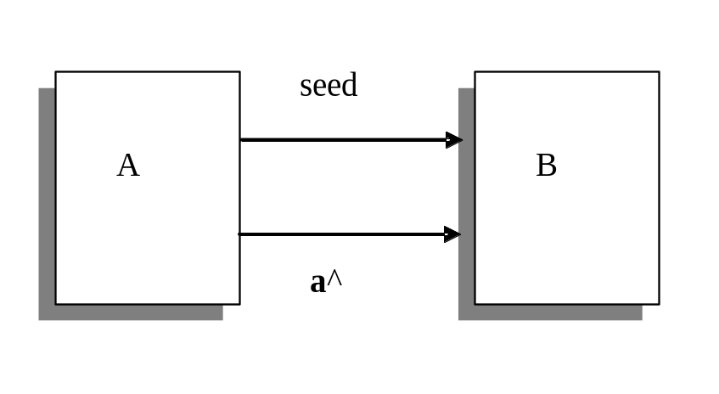
Cryptographic Methods:
Distributed Dot Product
The essence of the method :
send short k-dimensional (k <<n) messages instead of the original n-dimensional vectors a and b.

Slide 9


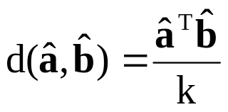
Distributed Dot Product:
Algorithm
The algorithm of computing a^{T}b works as follows
A sends B a seed of the random number generator
both A and B generate k by n matrix R populated by the entries coming from the random number generator (the generator produces numbers that are generated independently from some fixed distribution with zero mean and finite variance). At the sites computed are the vectors
B computes the expression

Slide 10
Privacy Versus Levels of Information
Granularity
All possible interaction could be realized through some interaction occurring at the higher level of abstraction delivered by information granules.
In objective function based fuzzy clustering, there are two important facets of information granulation conveyed by
partition matrices, and
(b) prototypes.

Slide 11
Information Granularity:
Partition Matrices and Prototypes
Partition matrices: a collection of fuzzy sets which reflect the nature of the data. Detailed numeric information is not revealed.
Prototypes: reflective of the structure of data and form a summarization of data. Given a prototype, detailed numeric data remains hidden

Slide 12
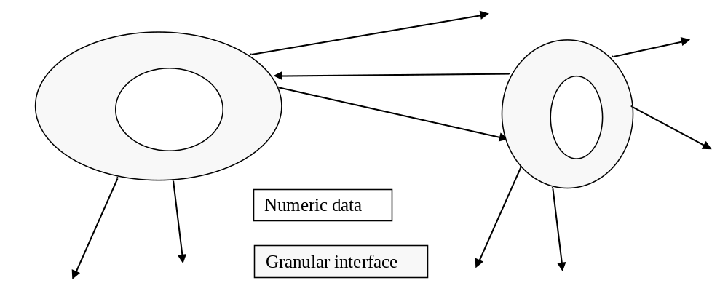
Granular Interfaces

Slide 13
Distributed Data Mining
We encounter situations where databases are distributed rather than centralized:
different outlets of the same company which operate independently and collect data about customers by populating their independent databases: banking, health care, sensor networks…
Under these circumstances, the “standard” data mining activities are to be revisited:
processing all data in a centralized manner cannot be exercised,
data mining of each of the individual databases could benefit from availability of findings coming from others.

Slide 14
Distributed Data Mining:
General Modes
The technical constraints and privacy issues dictate a certain level of interaction.
Two general modes of interaction:
collaborative clustering
consensus clustering

Slide 15
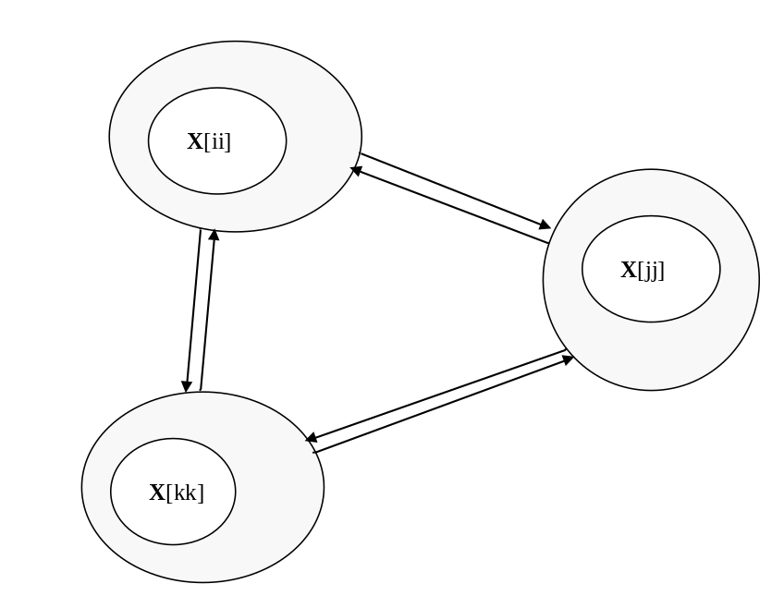
Collaborative Clustering
Communication through:
partition matrices – horizontal mode of collaboration
prototypes – vertical mode of collaboration

Slide 16
Two Modes of Collaborative Clustering
Consider data sites X[1], X[2], .. X[p]
“P” denotes the number of data sites
X[ii] - ii-th data set (square brackets identify a certain data set)
horizontal clustering : the same objects described in different feature spaces.
Example: the collection of the same patients coming with their records built within each medical institution.
vertical clustering: data sets are described in the same feature space but deal with different patterns.
Example: clients of different branches of the same institution described in the same way (the same feature space)

Slide 17
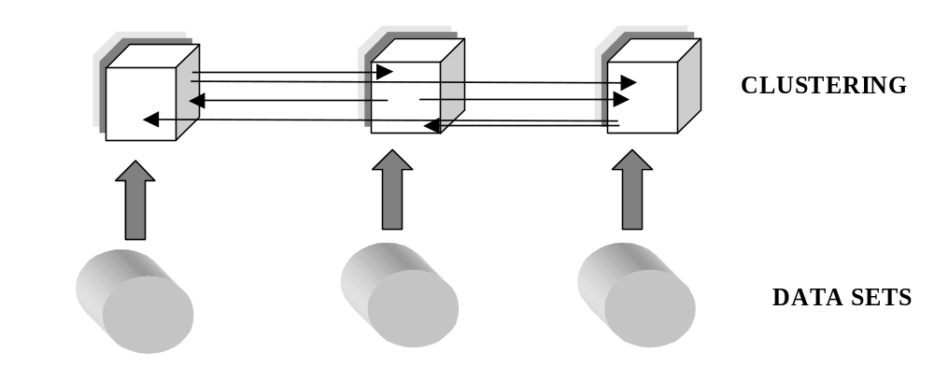
Horizontal Clustering

Slide 18
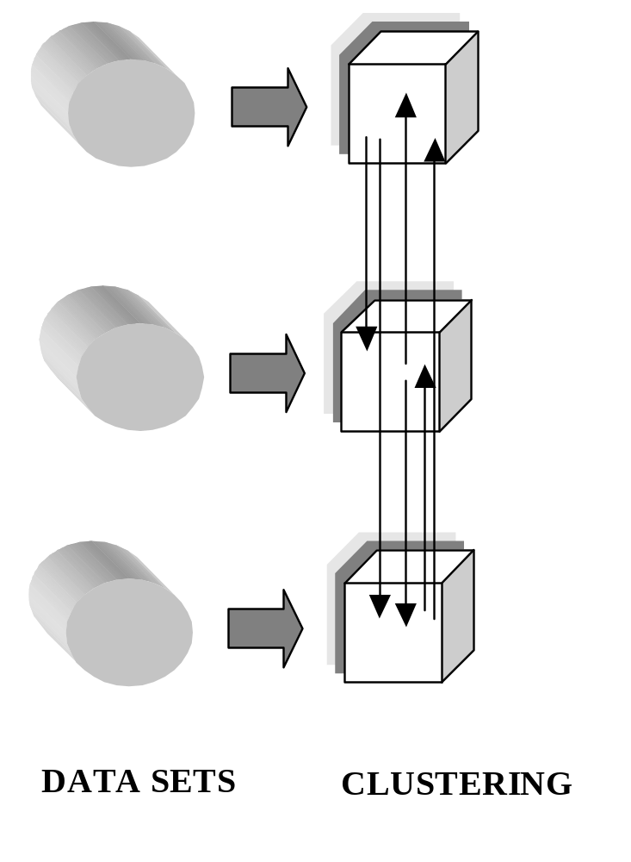
Vertical Clustering

Slide 19
Collaborative Clustering:
Key Features
The databases are distributed and there is no sharing of their content in terms of the individual records. This restriction is caused by some privacy and security concerns. The communication between the databases can be realized at the higher level of abstraction
Given the existing communication mechanisms, the clustering realized for the individual datasets takes into account the results about the structures of other datasets and actively engages them in the determination of the clusters; hence the term of collaborative clustering

Slide 20
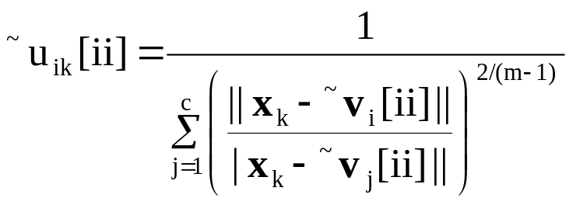
Vertical Mode of Clustering:
Algorithmic Developments
Consider fuzzy clustering FCM completed separately for each dataset.
The resulting structures represented by the prototypes are denoted by ~v1[ii], ~v2[ii], …, ~vc[ii] for the ii-the dataset and ~v1[jj], ~v2[jj], …, ~vc[jj].
Consider the ii-th data set:

Slide 21
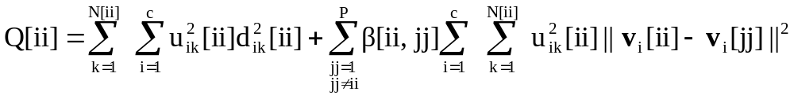
Vertical Mode of Clustering:
Augmented Objective Function
Collaboration with other data sites
“standard” FCM

Slide 22
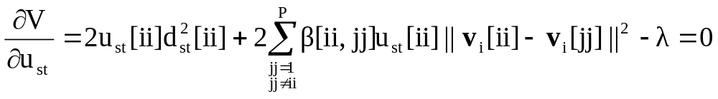
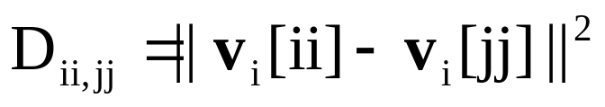
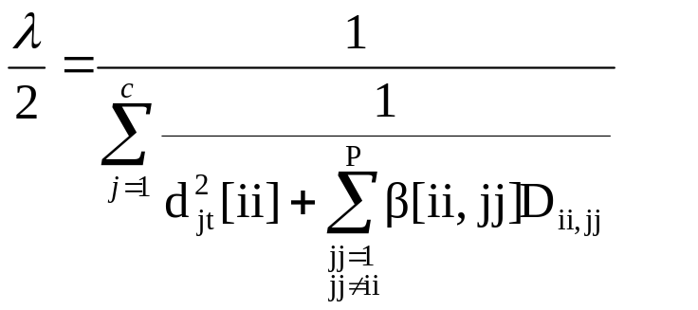
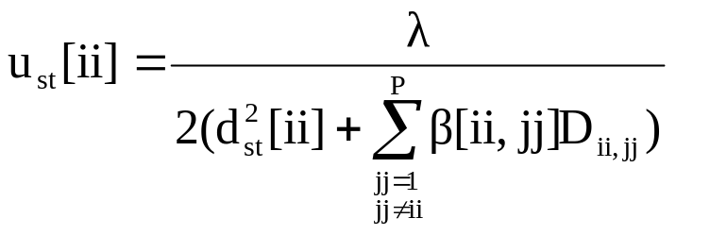
Vertical Mode of Clustering:
Detailed Derivations (1)
Introduce notation:

Slide 23
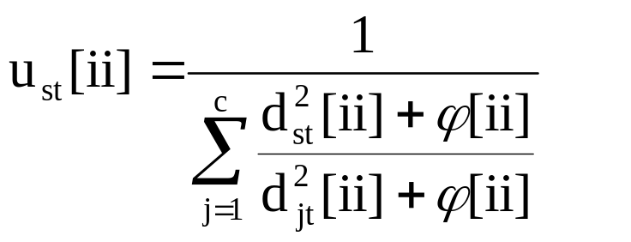
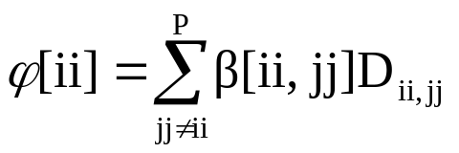
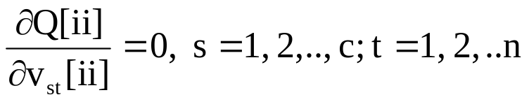
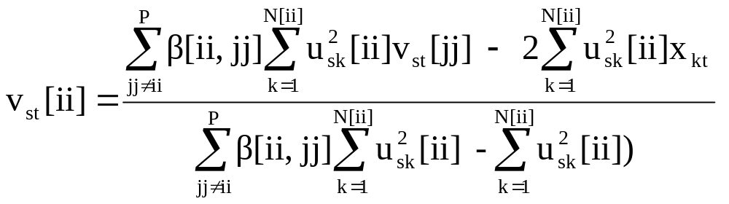
Vertical Mode of Clustering:
Detailed Derivations (2)

Slide 24
Consensus-Based Clustering
Consensus-based clustering focuses mainly on the reconciliation of differences between the individually developed structures.
As of now, we are concerned with a collection of clustering methods being run on the same dataset.
Hence U[ii], U[jj] stand here for the partition matrices produced by the corresponding clustering method.

Slide 25
Consensus-Based Clustering
Alleviating this problem: develop consensus at the level of the partition matrix and the proximity matrices being induced by the partition matrices associated with other data.
The use of the proximity matrices helps eliminate the need to identify correspondence between the clusters and handle the cases where there are different numbers of clusters used when running the specific clustering method. .

Slide 26
Consensus-Based Clustering
Determination of some correspondence between the prototypes (partition matrices) formed for by each clustering method becomes crucial
There are no linkages between them once the clustering has been completed. The determination of the correspondence is an NP complete problem and this limits the feasibility of finding an optimal solution.

Slide 27
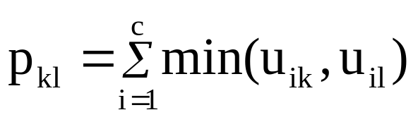
Proximity Matrix
Given is partition matrix U = [u_{ik}]
Proximity matrix P = [p_{kl}] is built on a basis
of two columns (k and l) of U
Properties of proximity matrix
p_{kk} =1 reflexivity
p_{kl} = p_{lk} symmetry

Slide 28
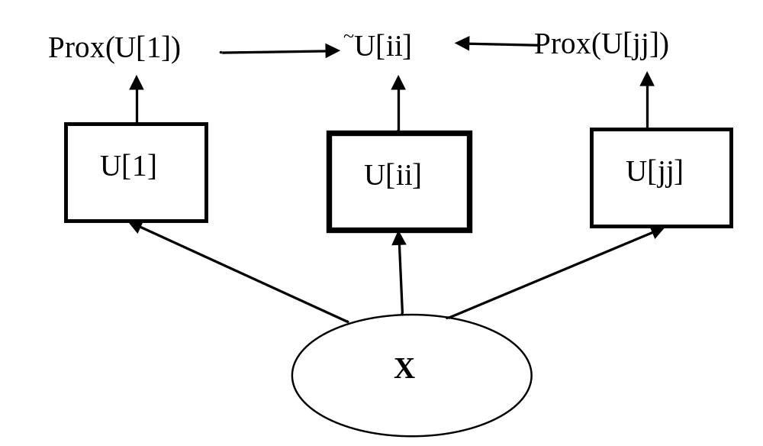
Consensus-Based Clustering:
Architecture

Slide 29
Consensus-Based Clustering:
Objective Function
Min wrt. ~U[ii]
Fuzzy partition matrix
to be optimized
Partition matrix associated with
data site “jj”

Slide 30
References
Cios, K.J., Pedrycz, W. and Swiniarski, R. 1998. Data Mining Methods for Knowledge Discovery. Kluwer
Da Silva, JC, Giannella, C., Bhargava, R, Kargupta, H. and Klusch, M.2005. Distributed data mining and agents, Engineering Applications of Artificial Intelligence, 18, 7, 791-807
Pedrycz, W. 2005.Knowledge-Based Clustering: From Data to Information Granules, J. Wiley
Verykios, VS., Bertino,E., Fovino IN, Provenza, LP. Saygin, Y and Theodoridis Y. 2004. State-of-the-art in privacy preserving data mining. SIGMOD Record 33, 1, 50–57
Wang; K. Yu, PS and Chakraborty, S. 2004. Bottom-up generalization: a data mining solution to privacy protection, Proc.. 4th IEEE International Conference on Data Mining, ICDM 2004, 249 - 256

